Slide 1
Distribution of FIFA World Cup hosts and winners

Slide 2
Ideas & Aims
The main aim of the research is to analyze the distribution of FIFA World Cup hosts and winners and find any patterns in this data.
Make the distribution of hosts and winners on the map using geojson
Compare different periods of time
Compare hosts and winners

Slide 3
All the data was taken from Wikipedia: https://en.wikipedia.org/wiki/FIFA_World_Cup
https://en.wikipedia.org/wiki/FIFA_World_Cup_hosts
Visualized by:
http://geojson.io

Slide 4
Legend of the map
Blue marker — if the country was the winner
Red marker — if the country was the holder
Green marker — if the country both the holder and the winner in the same year
Lines connected with markers by the year of World Cup
I decide to split the data on two parts:
1930-1978 and 1982-2022,
In order to make data more demonstrative

Slide 5
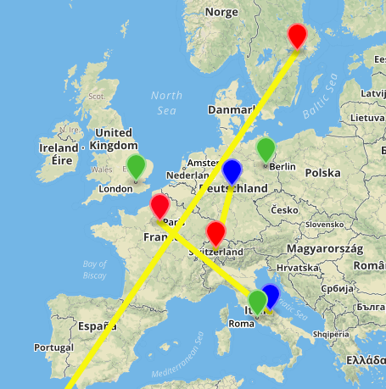
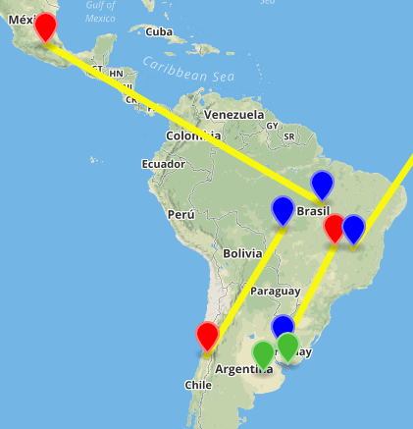
1930-1978
-11 tournaments
-5 winners while hosting

Slide 6
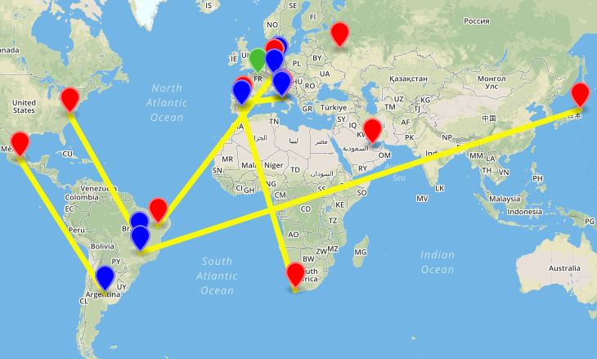
1982-2022
-9 ended tournaments
-2 upcoming tournaments
-1 winner while hosting
More detailed map you can find on GitHub:
https://github.com/NanairoNika/DigitalHumanities

Slide 7
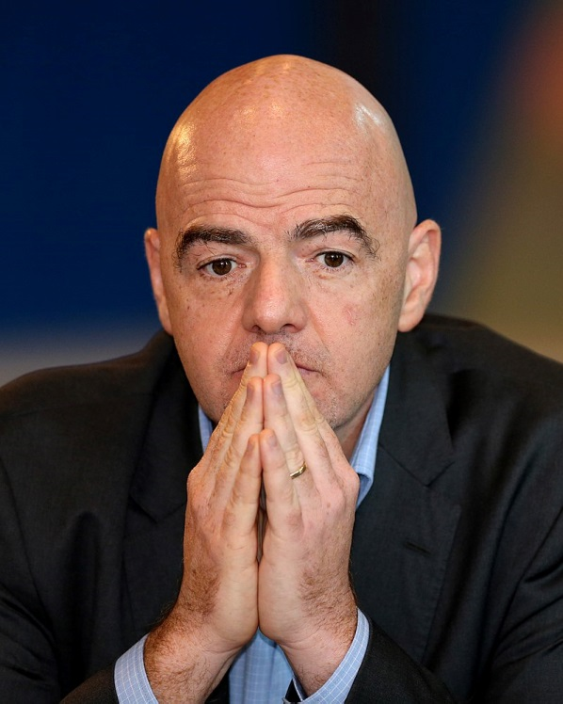


Interpretation & Conclusion
We can see that for the last 40 years only one holder of the World Cup won it at the same year. Although for the period from 1930 to 1978 it happened 5 times. I think, that means that football is spreading and footballers from many countries are playing in top teams, football is not the game for limited amount of countries. The number of teams taking part in World Cup increasing, that makes win much harder to reach. Also makes sence new policy of FIFA to develop football in different countries like Japan, South Africa, Qatar and even Russia.
Also we can see that really few of countries won Cup from different part of the world from the holder. It really makes sence. I guess the crowd, the support of the fans helps a lot at the matches, and of cource for the same part of the world is much more easier to get on the Cup.

